Slide 1
High Lane Phonics Parent Information Meeting

Slide 2
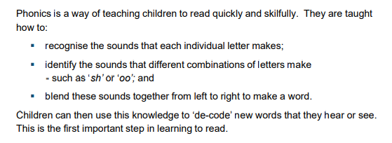
What is phonics?
A method of teaching people to read by correlating sounds with symbols in an alphabetic writing system.
What do the DFE say?

Slide 3
Pure sounds:
https://www.youtube.com/watch?v=UCI2mu7URBc
Phonics Terminology: See phonics glossary

Slide 4
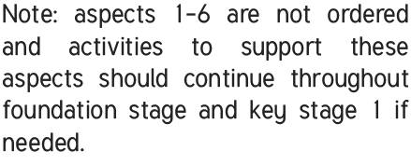
Phases in Phonics
Phase One
Phase one consists of 7 aspects:
Environmental sounds
Instrumental sounds
Body percussion
Rhythm and Rhyme
Alliteration
Voice sounds
Oral Blending and Segmenting
Phase 1 phonics is taught in nursery and reception. It is important that children are secure in phase one before moving onto aspect 7 and the other phases. This should always be recapped in lessons throughout reception, and KS1.

Slide 5
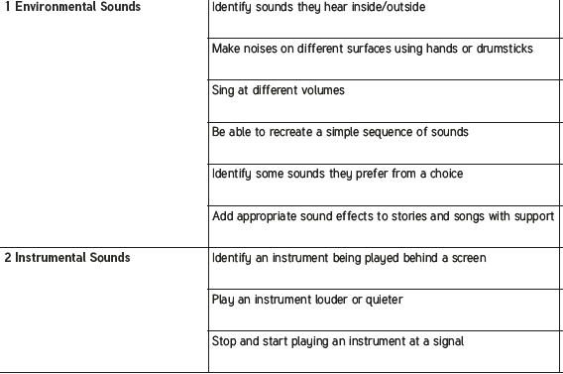
Phases in Phonics Phase 1 examples.

Slide 6
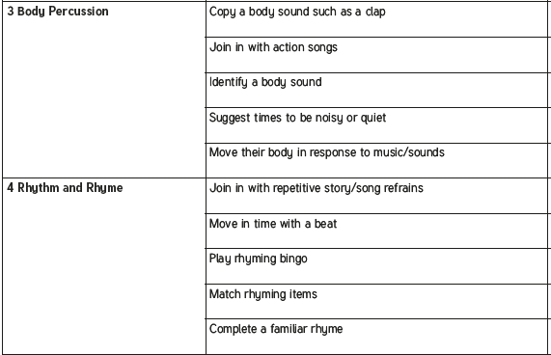
Phases in Phonics Phase 1 examples.

Slide 7
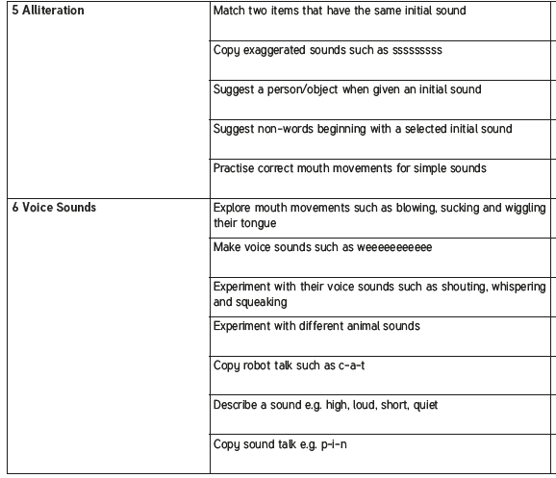
Phases in Phonics Phase 1 examples.

Slide 8
Phases in Phonics Phase 1 examples.

Slide 9
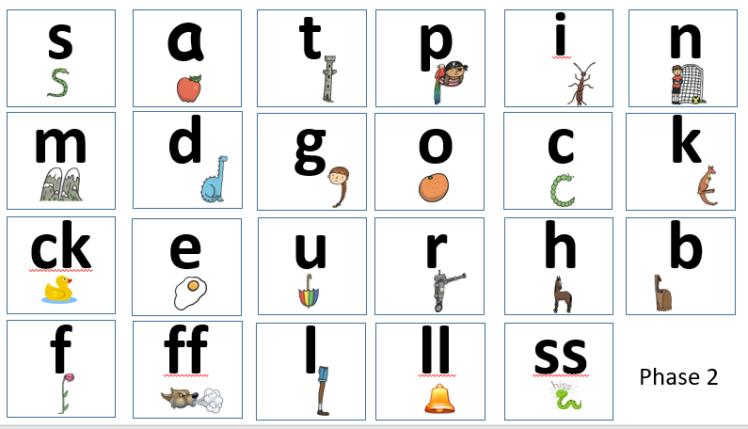
Phases in Phonics
Phase 2

Slide 10
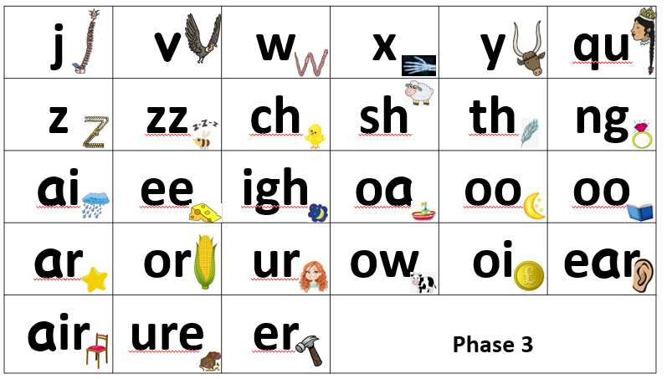
Phases in Phonics
Phase 3

Slide 11
Phases in Phonics
Phase 4
Phase four is a recap of all learnt graphemes in phase 2 and phase 3. In phase 4 we look as more complex structures of words and make sure children can blend and segment constant blends. This is particularly important for segmenting to spell.
For example:
ccvc – stop, train, crab
cccvc – strap, strong, splat
cvcc –desk, hand, lunch, thump
ccvcc- skunk, stamp, drift, crunch
Best practice is to incorporate phase four into all other phases
Phase 2
Phase 3

Slide 12
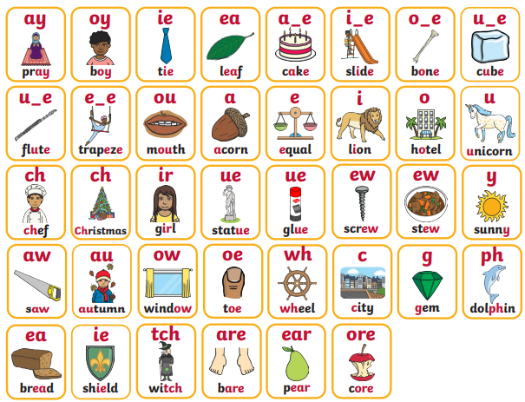
Phases in Phonics
Phase 5

Slide 13
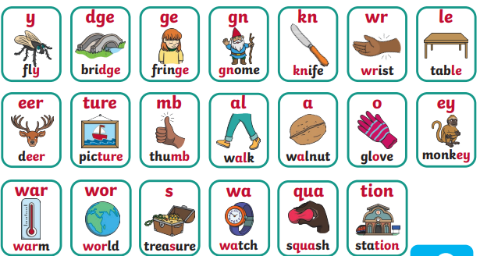
Phases in Phonics
Phase 6

Slide 14
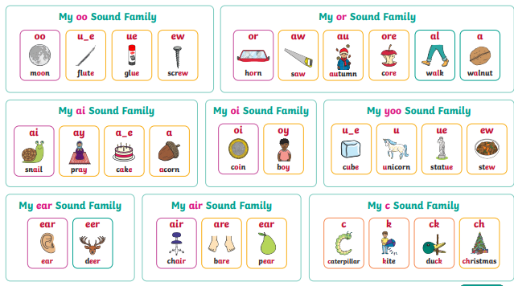
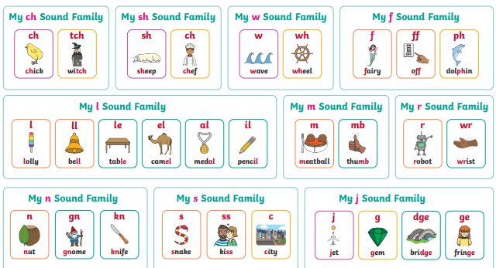
Phases in Phonics
Grow your code:

Slide 15
Phonetically plausible spelling:
Reception and Year 1:
Spelling can be phonetically plausible using graphemes they know.
The fruit pear spelt ‘pair’ would be acceptable as they don’t learn the ear grapheme making the air phoneme until year 2.
Year 2 onwards: there is an expectation that children use all known graphemes and spelling rules to make accurate spelling choices.

Slide 16
What do our phonics lessons look like at High Lane?
Lesson format:
Revisit and review
Oracy
Teach – new grapheme, reading words containing that grapheme, Alien words
Practice
Apply – read sentence
Teach – writing grapheme, Spelling words containing that grapheme (I do, We do)
Apply – You do words OR a sentence.

Slide 17
What can you do at home?
Phonics –
Sound hunts
Sound talk instructions
Games - snap
Ed Shed
Phonics videos – Mr Thornes Phonics
Practice pure sounds
Reading-
Read every day (phonics Book, shared read book, library book, bed time story)
Leave notes around the house for children to read
Treasure hunt clues
Board games
Spelling –
Shopping lists/to do list
Cards
Stories
Ed shed

Slide 18
Reading requires two skills
Understanding
The ability to understand the meaning of the words and sentences in a text.
The ability to understand the ideas, information and themes in a text.
If a child understands what they hear, they will understand the same information when they read.
Phonics and Word Recognition
The ability to recognise words presented in and out of context.
The ability to blend letter sounds (phonemes) together to read words.

Slide 19
Reading
Reading books should be easy and children should be 95% successful. They will contain GPC that the children have learnt and practiced in school. Most children should be able to remember words they have previously sounded out in and not have to sound out every word.
Re-reading is VERY important for fluency.
This looks like:
Going back to the start of the sentence after sounding out a word and reading from the beginning.
The barn is at the farm but the car is not.
If a child sounds out farm they go back to the start and read all words again without sounding out.
Re-reading books they find easy. Re-reading the same phonics book every day is a really good way to build up fluency. Fluency is the foundations of all reading and comprehension.

Slide 20
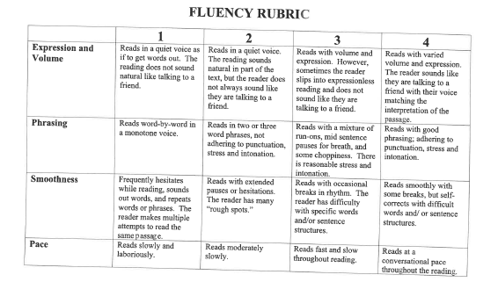

Slide 21
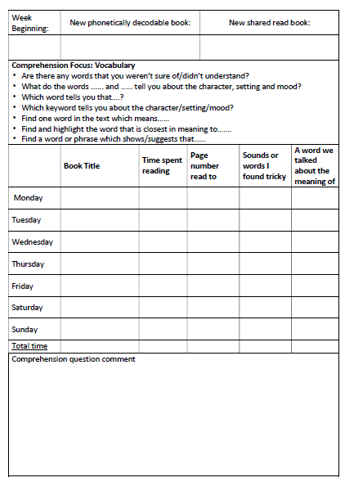

Slide 27
Supporting your child with reading
Use phonics first
Play games – flashcards can help with unfamiliar vocabulary or ‘tricky’ words (cannot be worked out by sounding out e.g said)
Use ‘book talk’ – talk about stories and story language, key features of the book, word level – words, sentences, punctuation, features on the page e.g. speech bubbles
Check understanding – encourage use of picture clues to help understanding, also show your child how you might be able to predict the meaning from other word clues.
Use question prompts to help deepen your child’s understanding and support their reading development
Model
Read in your home language!

Slide 28
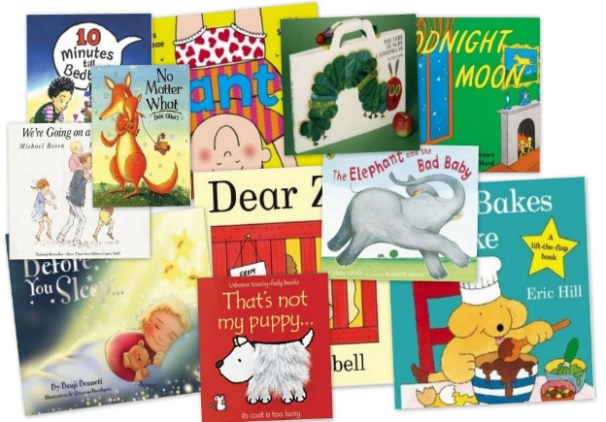
What to do if your child is stuck
Use phonics first. What sound does the word begin with? Can you say the sounds in the word? Blend them together.
Read to the end of the sentence. What would make sense?
What is the text about? What might fit here?
Does it sound right?
Look at the picture. Does it help?
Notes:
Talk through each strategy and explain what each will do to help the child decode a word that they cannot read.
Independent Strategies by Jill Marie Warner

Slide 29
How to use these strategies at home
John let his pet frog go.
It ******across the grass.
What is the first sound?
It h***** across the grass.
What would make sense?
It hopping across the grass.
Does that sound right?
It hopped across the grass.

Slide 30
Talking about books
Do you like this book; why?
Who is your favourite character?
Tell me about a character in the book.
Which words tell you what the character is like?
How would you feel?
What do you think will happen next?
What would you do?
What have you learned about …… in your book?
What can you tell me about…?
Its not a test!

Slide 31
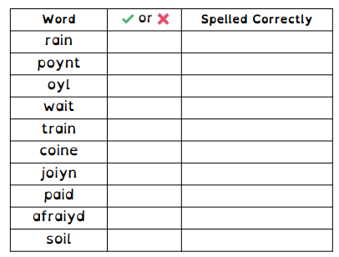
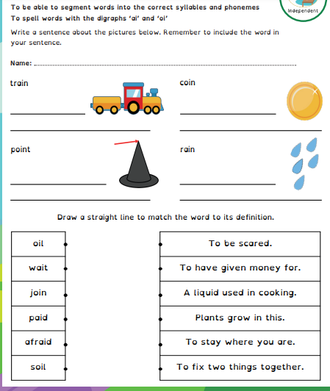
Spelling:
Sound buttons – dots and dashes
Ed shed spelling scheme links with phonics– al covered in phonics, year 2 spelling and year 3 spelling. Ph year 1 phonics, year 6 spellings.

Slide 32
Statutory assessments
Year 1 Phonics screening assessment (usually in June)–
The phonics screening check is a check of your child’s phonics knowledge. It helps your school confirm whether your child is making the progress expected in the national curriculum.
The phonics screening check contains 40 words divided into two sections of 20 words.
Both sections contain a mixture of real words and pseudo-words. Pseduo-words are words that are phonically decodable but are not actual words with an associated meaning. Pseudo-words are included in the check specifically to assess whether your child can decode a word using their phonics skills.
All pseudo-words in the check are accompanied by a picture of an imaginary creature. Children are taught that when a word has a creature next to it, it is a pseudo-word. This is to ensure that they are not trying to match the pseudoword to a word in their vocabulary.
The check is designed to give teachers information on how your child is progressing in phonics. It will help to identify whether your child needs additional support at this stage so that they do not fall behind in this vital early reading skill.

Slide 33
Any questions ?

